Slide 1
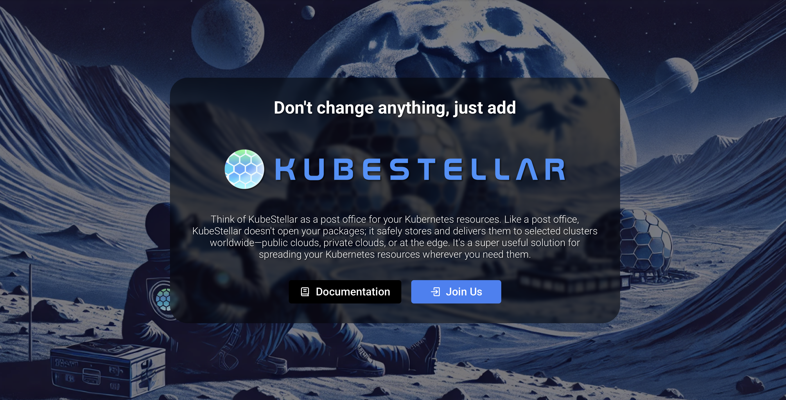

KubeStellar CONTRIBFEST KubeCon EU 2025
We are a Cloud Native Computing Foundation sandbox project.

Slide 2
Placeholder: Infomercial

Slide 3
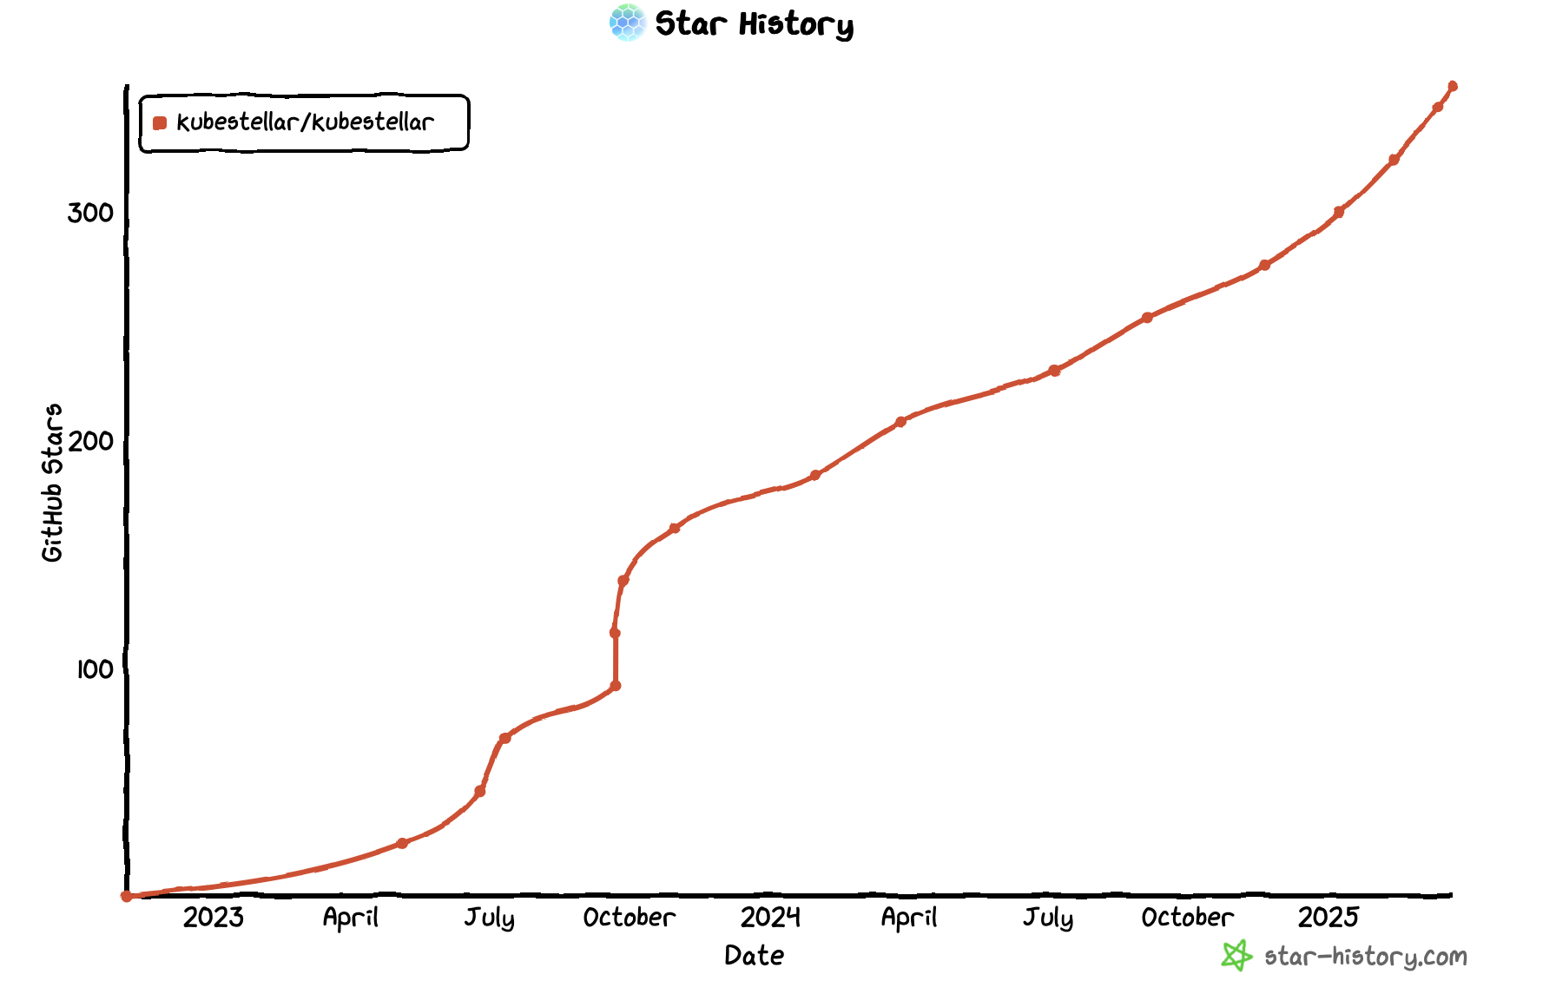

Slide 4
How can you help us?

Slide 5
kubestellar/kubestellar

Slide 6
Placeholder: KubeStellar Demo Installation

Slide 7
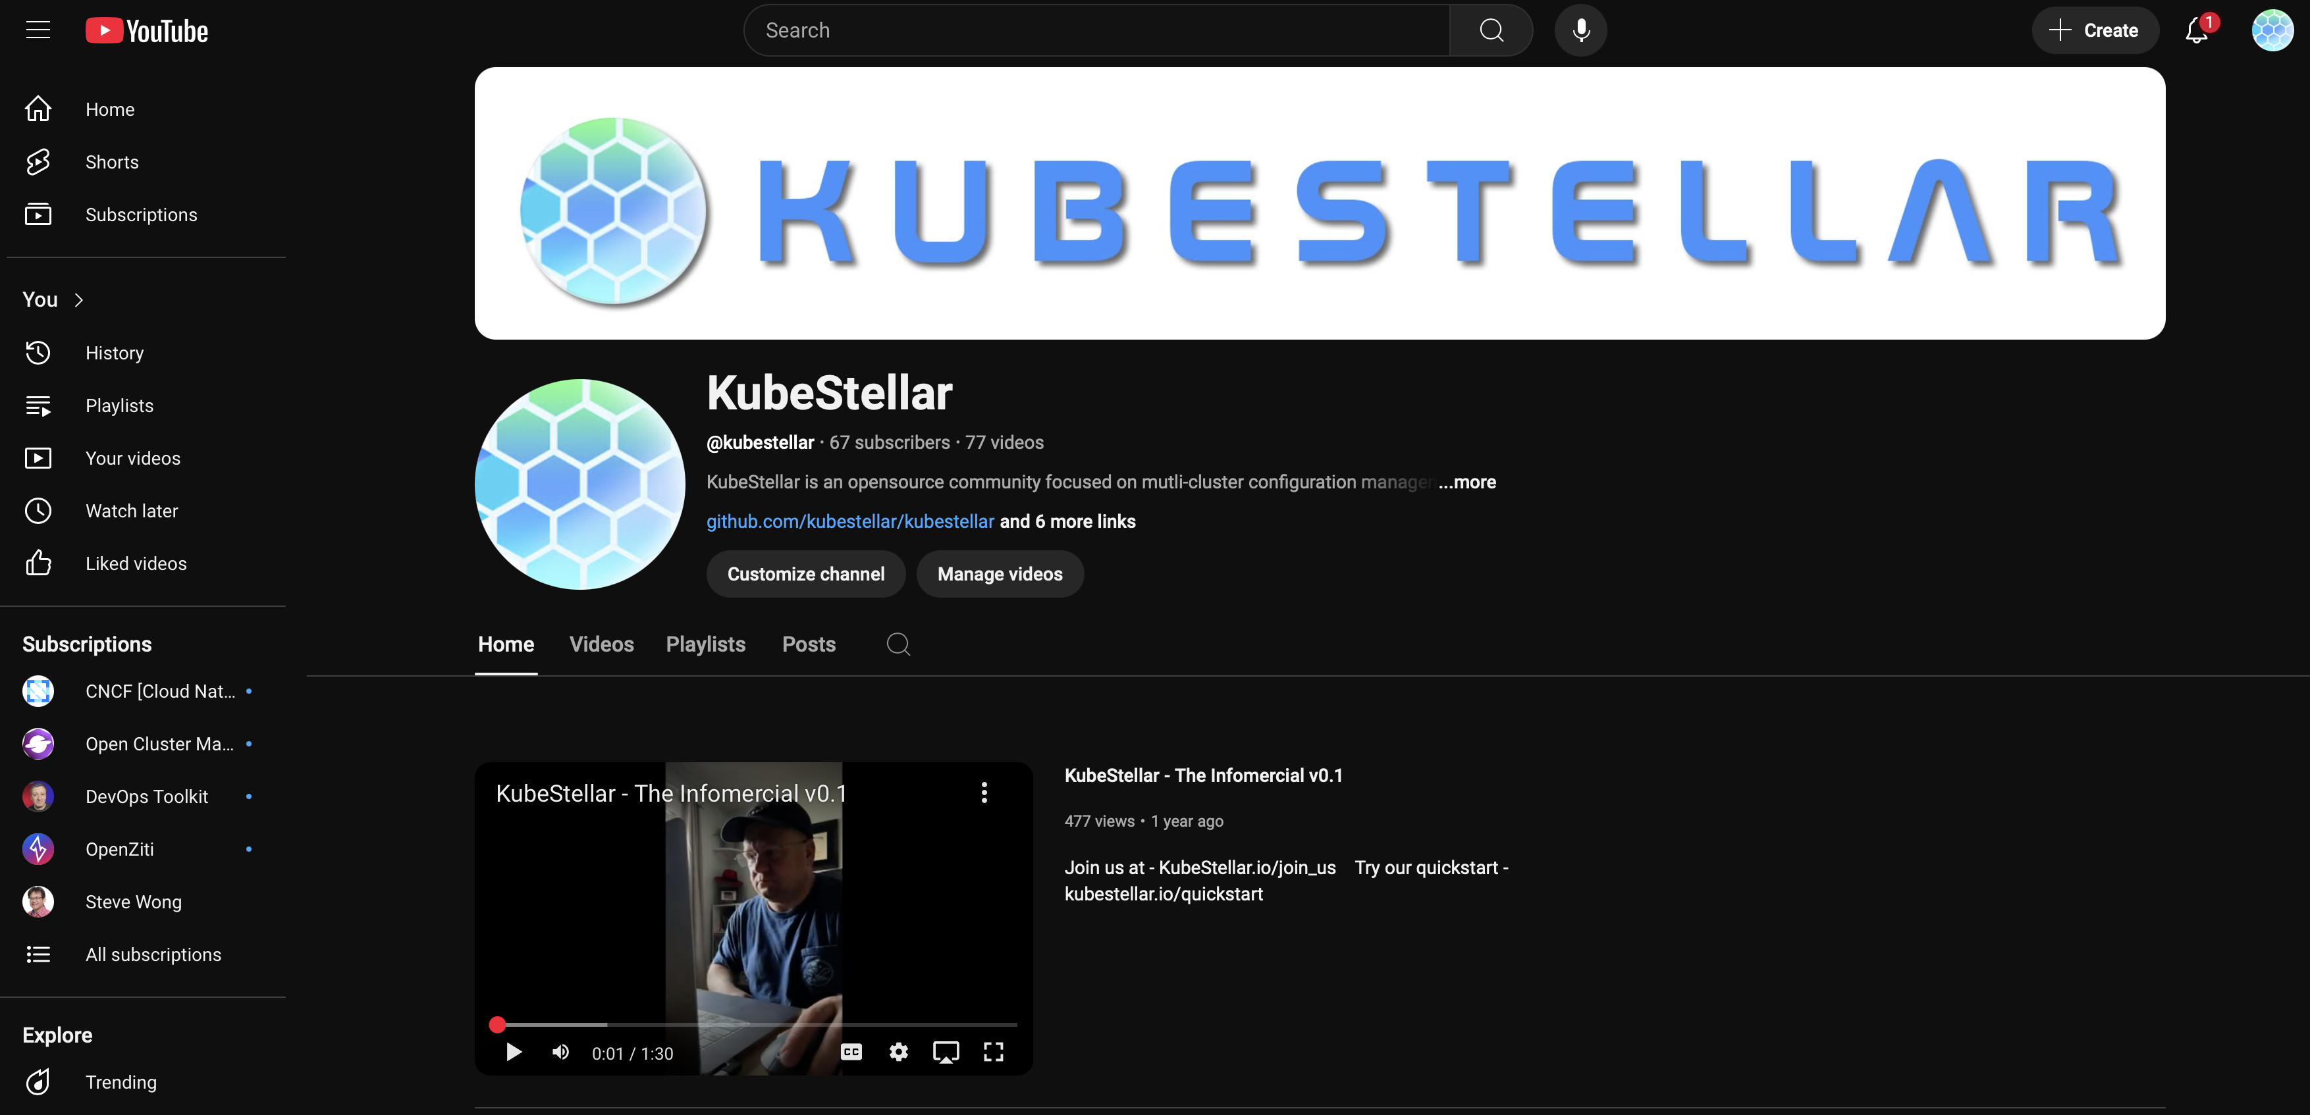
YouTube: Review Our Project, Create a new Infomercial

Slide 8
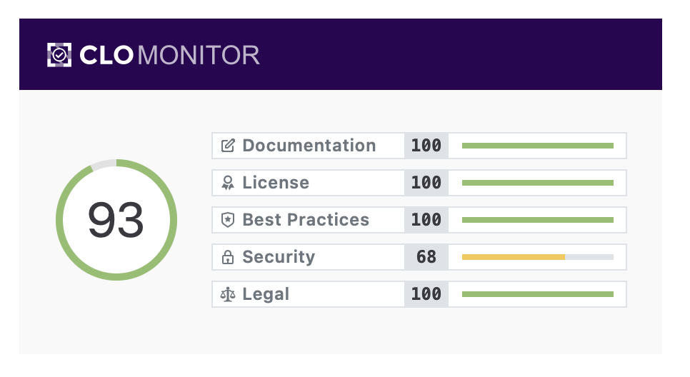

Slide 9
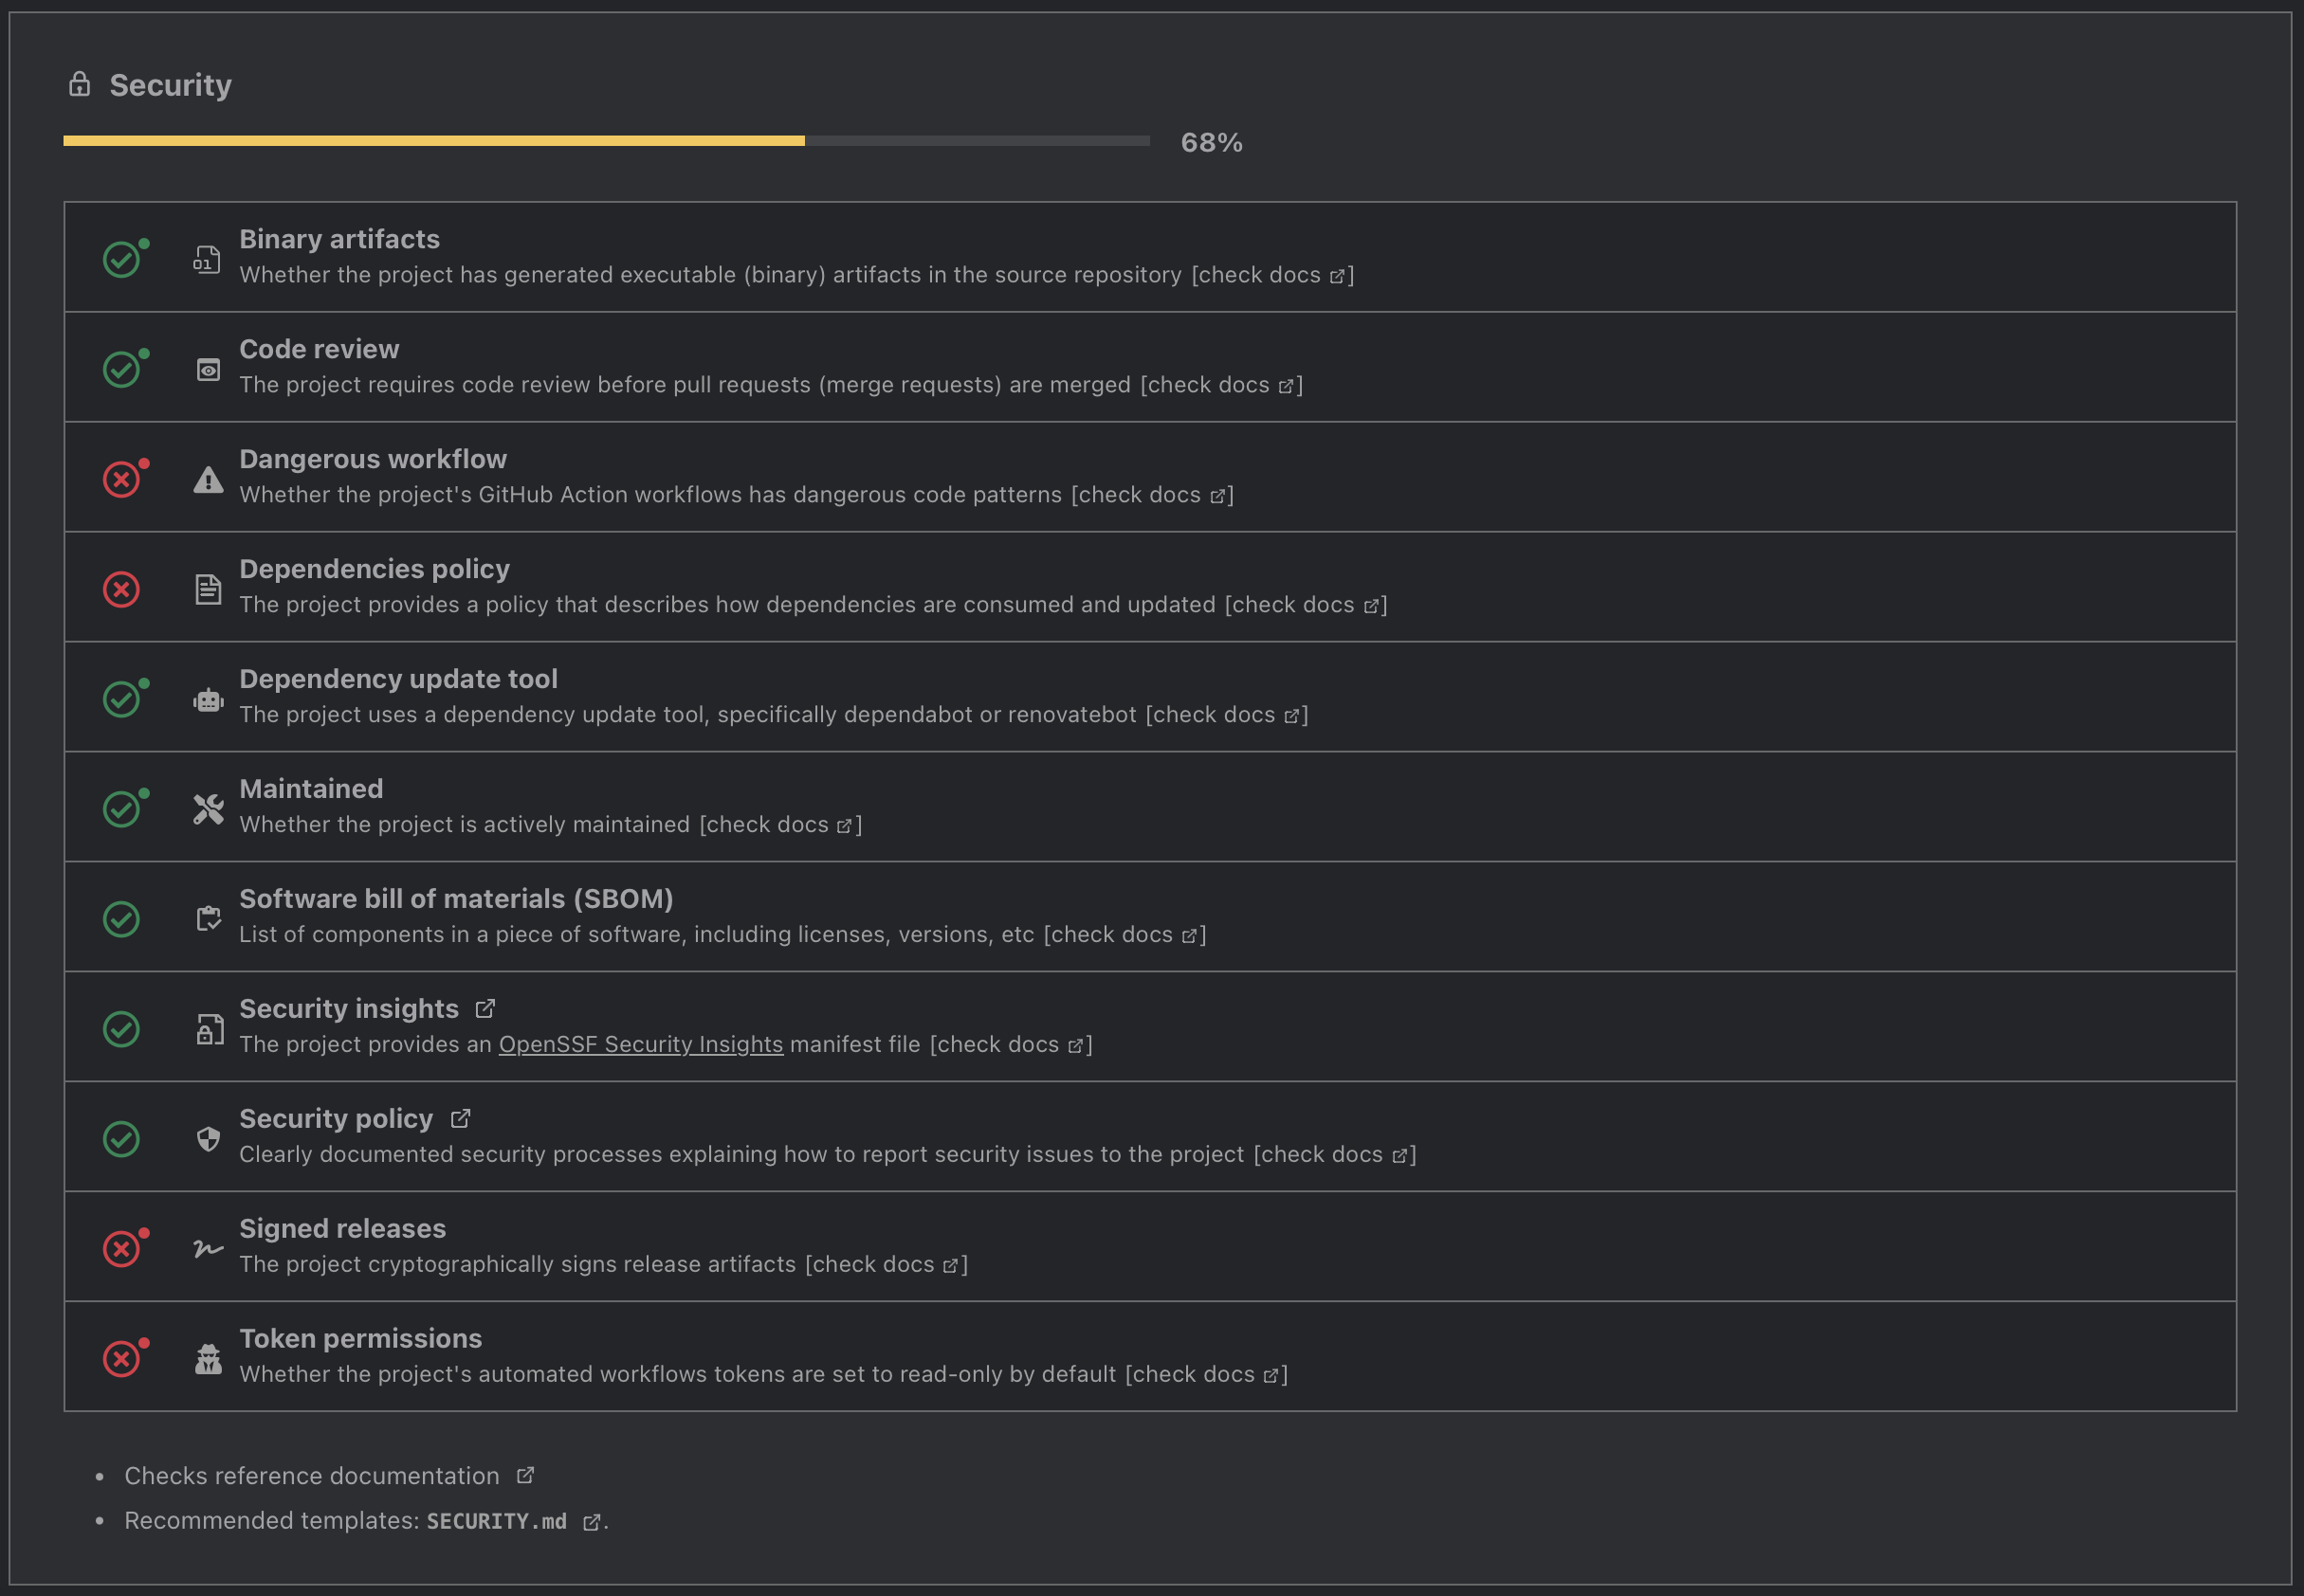
GitHub Security: Clomonitor.io

Slide 10
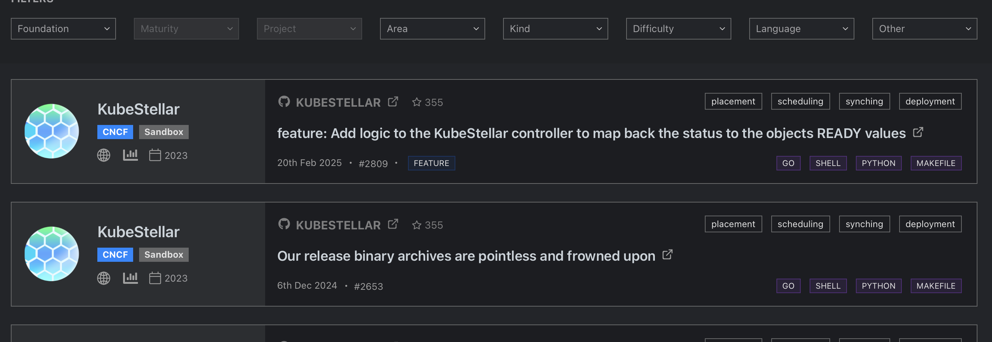
How do I find `Good First` and `Help Wanted` Issues? Clotributor.io

Slide 11
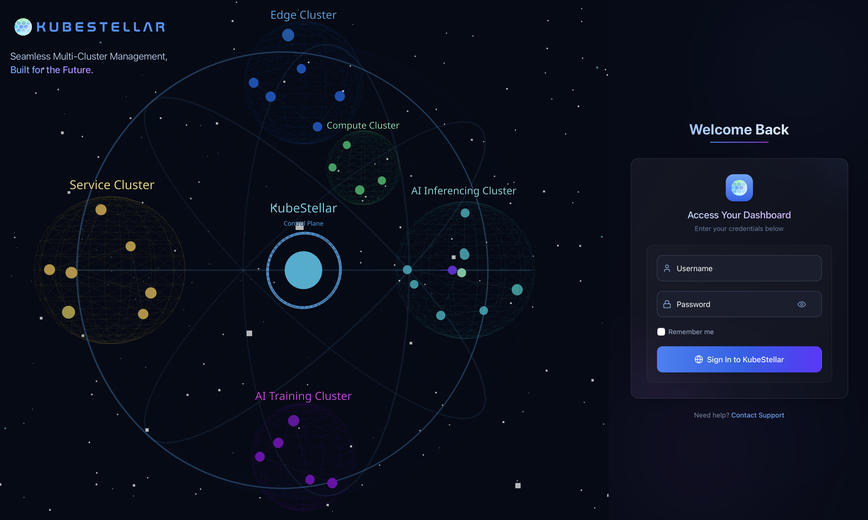

Slide 12
Placeholder: KubeStellar UI Demo

Slide 13
kubestellar/kubeflex

Slide 14

KubeStellar
Workload Definition Spaces (WDS)
Placement Policies
Workloads
Workload Execution Clusters
SIG MC Work API
Inventory API
Inventory & Transport Space (ITS)
(OCM, Native, Others)
Workloads are standard Kubernetes objects (deployments, pod, jobs etc.) – no bundling required
Placement Policies specifies what objects should be deployed where
WDS: KubeStellar Managed-Spaces (vanilla k8s) or hosting cluster/external
ITS: KubeStellar Managed-Spaces (OCM on vcluster, multicluster-controlplane) or hosting cluster/external: OCM/ACM

Slide 15
KubeFlex
KubeFlex is the space manager for KubeStellar
A Space (a.k.a. ControlPlane) is an abstraction that represents a Kubernetes API Server and related controllers.
There are different types of spaces:
k8s: vanilla upstream Kube API Server + Controller Manager Subset
Similar behavior to kcp’s Workspaces
Lightweight – about 350 MB Mem/Instance w/ shared Postgres DB
vcluster: runs community vcluster
~ 500 MB / instance
host: exposes hosting cluster with the same space abstraction.
external: imports external clusters under the same abstraction
multicluster-controlplane: “lite” ocm
Framework is extensible and allow adding more types.
Space 1
(k8s)
Space 2
(vcluster)
Space 3
(host)
Space 4
(external)
Space Manager
(KubeFlex)
Kubernetes Hosting Cluster

Slide 16







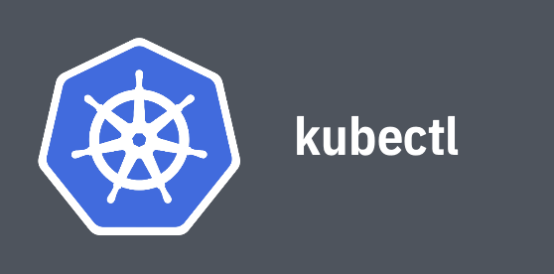



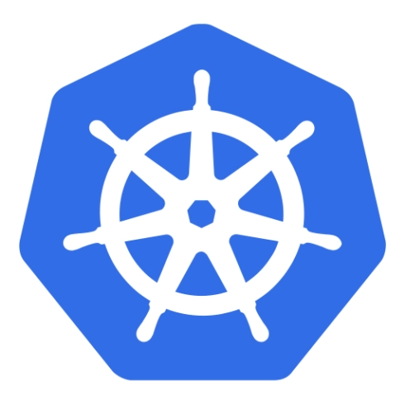
KubeFlex Architecture
Control Plane 1 Namespace
kubeflex-system namespace
Shared DB
Shared DB
kubeconfig
Choice of
or
kubectl commands
ControlPlane 1 CR
create
init
ControlPlane 2 CR
Operator
Control Plane 2 Namespace
kubectl commands
Dedicated DB
kubeconfig
Hosting Cluster

Slide 17
Post-Create Hooks
Post-Create Hooks allow users to start controllers connected to control planes, apply CRDs or other templates, or run commands against that space as Jobs (e.g., clusteradm)
ControlPlane 1 Namespace
CP 1
(k8s)
KubeStellar Controller Manager
Example: Bringing up KubeStellar WDS and OCM spaces:
kflex create wds1 –t k8s –p kubestellar kflex create ocm1 –t vcluster –p ocm
KubeFlex
Controller
ControlPlane 2 Namespace.
CP 2
(vcluster)
Job clusteradm
–p kubestellar : starts the KubeStellar controller Manager connected to space1
-p ocm : runs a job that runs clusteradm vs. space2 vcluster
Hosting Cluster

Slide 18
Placeholder: KubeFlex Demo

Slide 19
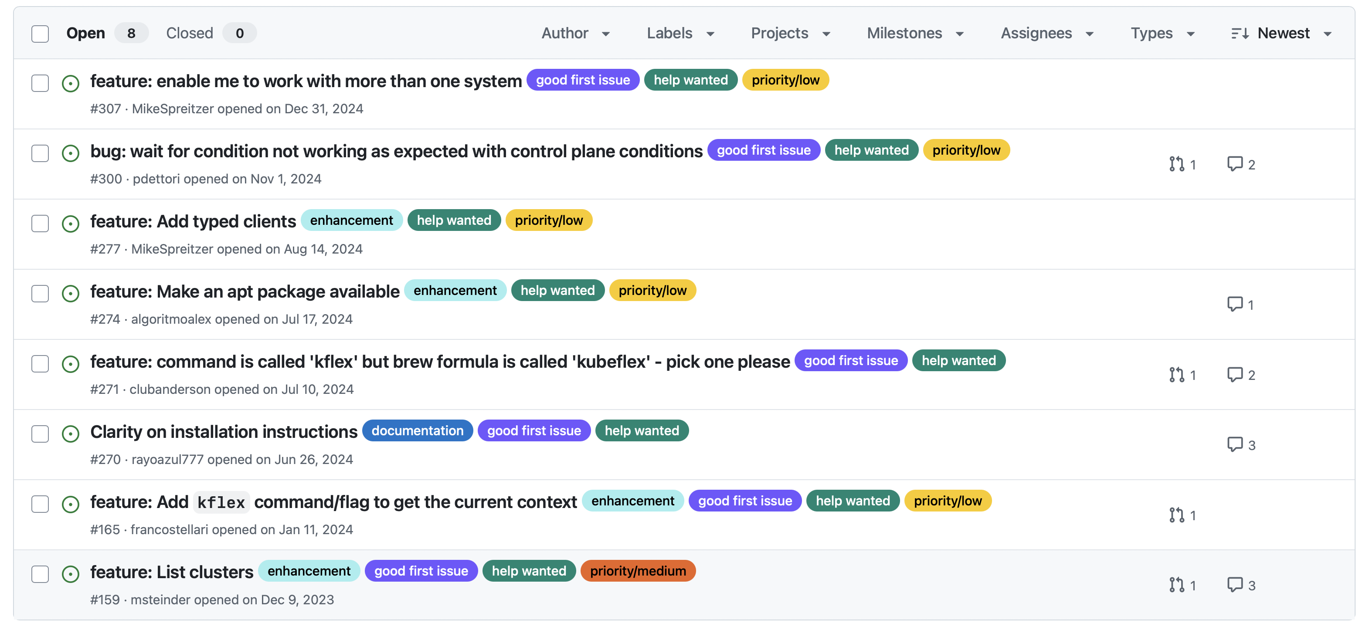
We need your help !
KubeFlex Help Wanted Issues
PRs in progress by KubeFest contributors
( a shout-out to Asmit Kumar Rai!)

Slide 20
KubeStellar Core Helm Chart
Franco Stellari

Slide 21
Key features of KubeStellar Core Helm chart
Support both Kubernetes (including Kind and k3d) and OpenShift clusters
Allow to deploy or reuse an existing KubeFlex controller
Allow to create a user-defined list of KubeStellar Inventory and Transport Spaces (ITSes) and Workload Description Spaces (WDSes)
Can use all the Control Planes types supported by KubeFlex, such as: vclusters, k8s, hosting cluster, and external clusters
Can deploy or reuse an Open Cluster Management (OCM) hub in the its ITSes
Hosting cluster
its0 (type: host)
wds0 (type: host)
KubeStellar Core Helm chart
KubeFlex controller
its1 (type: vcluster)
wds1 (type: h8s)
External OCM hub
its2 (type: external)

Slide 22
Deploying KubeStellar Core Helm chart
helm install ks-core \
oci://ghcr.io/kubestellar/kubestellar/core-chart \
--version 0.27.0 \
--set-json='ITSes=[{"name":"its1"}]' \
--set-json='WDSes=[{"name":"wds1"}]'
Install KubeFlex controller (default behavior)
Create an its1 ITS of type vcluster (default behavior)
Create a wds1 WDS of type k8s (default behavior)
Install KubeFlex post-create hooks to deploy KubeStellar controllers in KubeFlex Control Planes
For more details, see https://github.com/kubestellar/kubestellar/blob/main/docs/content/direct/core-chart.md

Slide 23
Placeholder: KubeStellar Helm Demo

Slide 24
Adding a WDS to an existing KubeStellar core deployment
There are two ways of adding, for example, a wds0 WDS of type host
Update an existing chart (requires relisting the existing Control Planes):
Deploy a new chart while reusing the existing KubeFlex controller and hooks:
helm install ks-core \
oci://ghcr.io/kubestellar/kubestellar/core-chart \
--version 0.27.0 \
--set-json='ITSes=[{"name":"its1"}]' \
--set-json='WDSes=[{"name":"wds1"},{"name":"wds0","type":“host"}]'
helm install add-wds0 \
oci://ghcr.io/kubestellar/kubestellar/core-chart \
--version 0.27.0 \
--set='kubeflex-operator.install=false,InstallPCHs=false' \
--set-json='WDSes=[{"name":"wds0","type":“host"}]'
For more details, see https://github.com/kubestellar/kubestellar/blob/main/docs/content/direct/core-chart.md

Slide 25
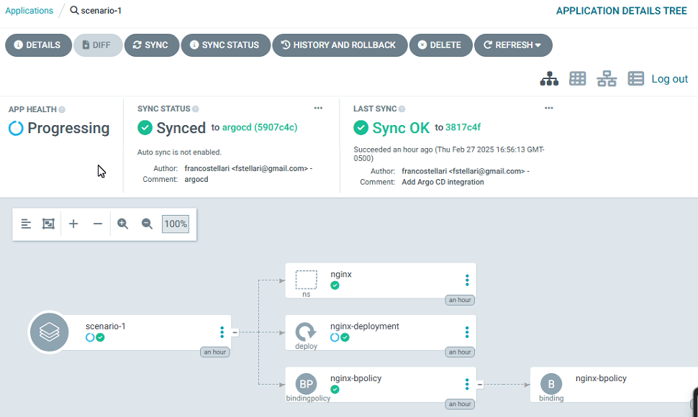
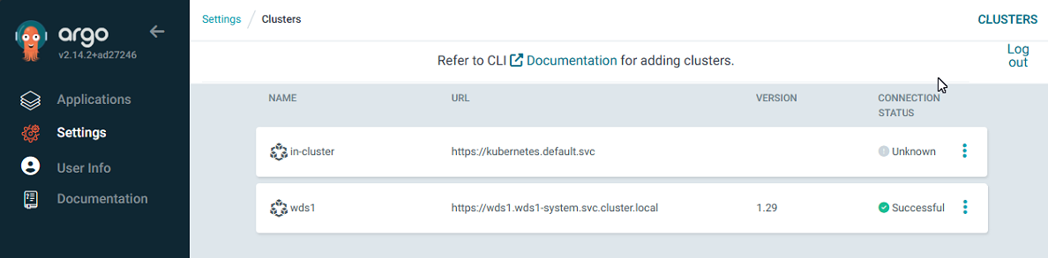
Current development effort for KubeStellar Core Helm chart
Implement an out of the box integration with Argo CD
Automatically register KubeStellar WDSes as Argo CD target clusters
Enable the creation of simple Argo CD applications
Please contribute to open PR #2818 and issue #2809

Slide 26
Key challenges that we had to overcome
The recently resolved Helm issue #12637 has prevented the effectively use of dependent charts when some of their values had to be removed/nulled out
For example, KubeFlex installation of PostgreSQL
To work around this issue, we had to:
Build and maintain a Helm container image
Develop Helm pre-install hook jobs and RBAC to manually deploy the dependent charts
KubeFlex chart
Helm pre-install hook
Helm job
PostgreSQL chart

Slide 27
Help KubeStellar project by contribution new features to Helm
It would be useful if the controllers/operators could add an annotation to the created resources to indicate to the Helm chart that it should wait for them as well before returning when the --wait flag is used
Introduce an annotation that would make Helm wait for user-specified resources Enable controllers/operators to add annotations to resources that they create to indicate to the Helm that it should wait for them before returning
Introduce priority/coordination of Helm resource creation Introduce a mechanisms, perhaps using annotations, to prioritize regular templated resources (like "helm.sh/hook-weight“ used for hooks ) creation and make some templated resources wait for other templated resource A ready/completed state
Introduce an alternative path for dependence chart override values) Introduce a new key to the dependent chart definition in the Chart.yaml to identify a specific path in the values.yaml file where the overrides of the dependent chart are located
Introduce a mechanism for a chart to require a specified Helm min version or range) Add a new key in the Chart.yaml to indicate, if any, a min version or a range of allowed versions of Helm CLI required for the chart installation

